Slide 1
Deep Learning Reading Group
Week 3

Slide 2
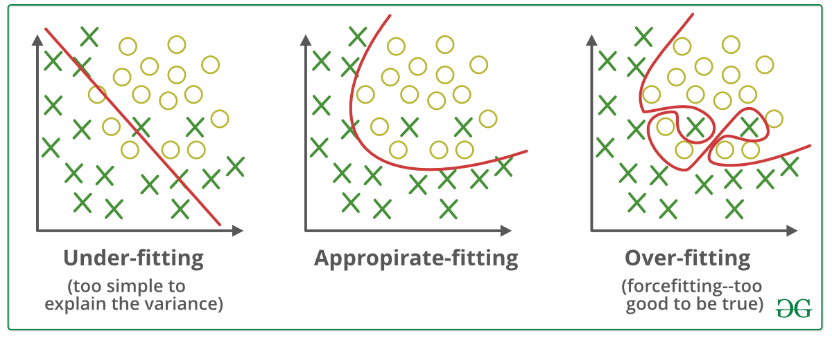
Overfitting & Underfitting
Image courtesy: https://towardsdatascience.com/underfitting-and-overfitting-in-machine-learning-and-how-to-deal-with-it-6fe4a8a49dbf

Slide 3
Underfitting
When the model can not reach the desired accuracy
Even after hyperparameter tuning
Cat vs Dog
You somehow know that the maximum possible accuracy should be around 99%
Your model is currently at 85%

Slide 4
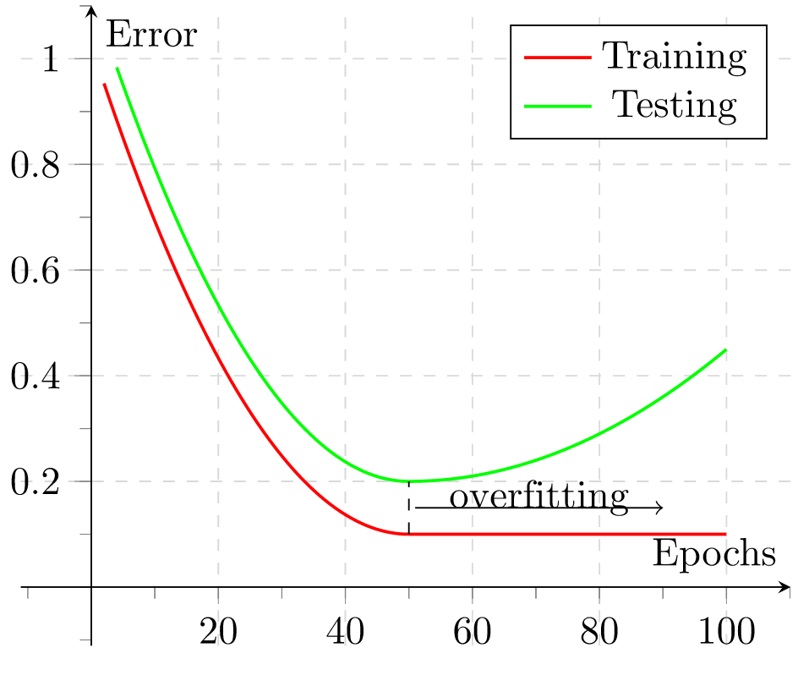
Overfitting
Image Courtesy: https://commons.wikimedia.org/wiki/File:2d-epochs-overfitting.svg

Slide 5
What to do when the model is underfitting
Increase the model size (such as number of neurons/layers)
Modify input features based on insights from error analysis
Reduce or eliminate regularization
L2 regularization, L1 regularization, dropout
Modify model architecture
ResNet, InceptionNet etc
Adding more training data does not help much

Slide 6
What to do when the model is overfitting
More data
Decrease model complexity
Cross-validation
Early Stopping
Pruning
Regularization
Feature Selection
Ensembling

